Slide 1
Chapter 4
The Social and Ethical
Perspectives of Entrepreneurship

Slide 2

The Social Entrepreneurship Movement
Social Entrepreneurship
  A new form of entrepreneurship applys to social problem solving traditional, private-sector entrepreneurship’s focus on innovation, risk-taking, and large scale transformation.
Social Entrepreneurship Process
  Recognition of a perceived social opportunity
  Translation of the social opportunity into an enterprise concept
  Identification and acquisition of resources required to execute the enterprise’s goals.

Slide 3
Social Entrepreneurs
Social Entrepreneur
  A person or small group of individuals who founds and/or leads an organization or initiative engaged in social entrepreneurship.
  Also referred to as “public entrepreneurs,” “civic entrepreneurs,” or “social innovators.

Slide 4
Social Entrepreneurs (cont’d)
Characteristics of Social Entrepreneurs
as Change Agents
  Adoption of a mission to create and sustain social value (beyond personal value)
  Recognition and relentless pursuit of opportunities for social value
  Engagement in continuous innovation and learning
  Action beyond the limited resources at hand
  Heightened sense of accountability

Slide 5
The Social Enterprise Challenge
Social Obligation
  Firms that simply react to social issues through obedience to the laws.
Social Responsibility
  Firm that respond more actively to social issues; accepting responsibility for various programs.
Social Responsiveness
  Firms that are highly proactive and are even willing to be evaluated by the public for various activities.

Slide 6
^{Table} 4.1 What Is the Nature of Social Enterprise?
Environment | Pollution control Restoration or protection of environment Conservation of natural resources Recycling efforts
Energy | Conservation of energy in production and marketing operations Efforts to increase the energy efficiency of products Other energy-saving programs (for example, company-sponsored car pools)
Fair Business Practices | Employment and advancement of women and minorities Employment and advancement of disadvantaged individuals (disabled, Vietnam veterans, ex-offenders, former drug addicts, mentally retarded, and hardcore unemployed) Support for minority-owned businesses
Human Resources | Promotion of employee health and safety Employee training and development Remedial education programs for disadvantaged employees Alcohol and drug counseling programs Career counseling Child day-care facilities for working parents Employee physical fitness and stress management programs
Community Involvement | Donations of cash, products, services, or employee time Sponsorship of public health projects Support of education and the arts Support of community recreation programs Cooperation in community projects (recycling centers, disaster assistance, and urban renewal)
Products | Enhancement of product safety Sponsorship of product safety education programs Reduction of polluting potential of products Improvement in nutritional value of products Improvement in packaging and labeling
Source: Richard M. Hodgetts and Donald F. Kuratko, Management, 3rd ed. (San Diego, CA: Harcourt Brace Jovanovich, 1991), 670

Slide 7

^{Table} 4.2 Classifying Social Enterprise Behavior
DIMENSION OF BEHAVIOR | STAGE ONE: SOCIAL OBLIGATION | STAGE TWO: SOCIAL RESPONSIBILITY | STAGE THREE: SOCIAL RESPONSIVENESS
Response to social pressures | Maintains low public profile, but if attacked, uses PR methods to upgrade its public image; denies any deficiencies; blames public dissatisfaction on ignorance or failure to understand corporate functions; discloses information only where legally required | Accepts responsibility for solving current problems; will admit deficiencies in former practices and attempt to persuade public that its current practices meet social norms; attitude toward critics conciliatory; freer information disclosures than stage one | Willingly discusses activities with outside groups; makes information freely available to the public; accepts formal and informal inputs from outside groups in decision making; is willing to be publicly evaluated for its various activities
Philanthropy | Contributes only when direct benefit to it clearly shown; otherwise, views contributions as responsibility of individual employees | Contributes to noncontroversial and established causes; matches employee contributions | Activities of stage two, plus support and contributions to new, controversial groups whose needs it sees as unfulfilled and increasingly important
Source: Excerpted from S. Prakash Sethi, “A Conceptual Framework for Environmental Analysis of Social Issues and Evaluation of Business Patterns,” Academy of Management Journal (January 1979): 68. Copyright 1979 by the Academy of Management. Reproduced with permission of the Academy of Management
© 2012 Cengage Learning. All rights reserved.

Slide 8

Environmental Awareness
Ecovision
  A leadership style that encourages open and flexible structures that encompass the employees, the organization, and the environment, with attention to evolving social demands.
© 2012 Cengage Learning. All rights reserved.

Slide 9

Environmental Awareness
Key Steps in an Environmental Strategy
  Eliminate the concept of waste.
  Restore accountability.
  Make prices reflect costs.
  Promote diversity.
  Make conservation profitable.
  Insist on accountability of nations.
© 2012 Cengage Learning. All rights reserved.

Slide 10

The Ethical Side of Entrepreneurship
Why are ethics important?
What exactly represents right or wrong conduct?
How do we develop our own codes of conduct?
What impact does integrity and ethical conduct have on creating a successful venture?
© 2012 Cengage Learning. All rights reserved.

Slide 11
Defining Ethics
Ethics
  A set of principles prescribing a behavioral code that explains what is good and right or bad and wrong; ethics may outline moral duty and obligations.
  Provide the basic rules or parameters for conducting any activity in an “acceptable” manner.
Reasons for Ethical Conflicts
  The many interests that confront business enterprises both inside and outside the organization
  Changes in values, mores, and societal norms
  Reliance on fixed ethical principles rather than an ethical process
© 2012 Cengage Learning. All rights reserved.

Slide 12
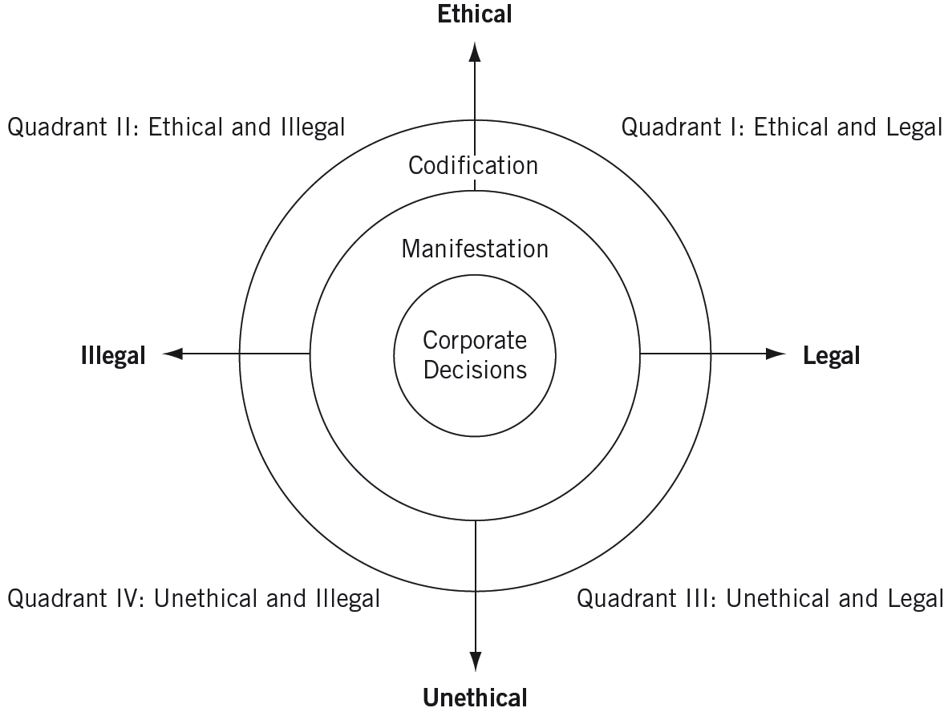
^{Figure} 4.1 Classifying Decisions Using a Conceptual Framework
Source: Verne E. Henderson, “The Ethical Side of Enterprise,” Sloan Management Review (spring 1982): 42.
© 2012 Cengage Learning. All rights reserved.

Slide 13
Ethics and Laws
Managerial Rationalizations
  Justifications in defense of unethical acts are believing that an activity:
    Is not “really” illegal or immoral.
    Is in the individual’s or the corporation’s best interest.
    Will never be found out.
    That helps the company will be condoned by the company.
© 2012 Cengage Learning. All rights reserved.

Slide 14
^{Table} 4.3 Types of Morally Questionable Acts
Type | Direct Effect | Examples
Nonrole | Against the firm | Expense account cheating Embezzlement Stealing supplies
Role failure | Against the firm | Superficial performance appraisal Not confronting expense account cheating Palming off a poor performer with inflated praise
Role distortion | For the firm | Bribery Price fixing Manipulating suppliers
Role assertion | For the firm | Investing in South Africa Using nuclear technology for energy generation Not withdrawing product line in face of initial allegations of inadequate safety
Source: James A. Waters and Frederick Bird, “Attending to Ethics in Management,” Journal of Business Ethics 5 (1989): 494.
© 2012 Cengage Learning. All rights reserved.

Slide 15
The Matter of Morality
Ethical conduct may reach beyond the limits of the law.
  The requirements of law may overlap at times but do not duplicate the moral standards of society.
  Legal requirements tend to be negative (forbidding acts), whereas morality tends to be positive (encouraging acts).
  Legal requirements usually lag behind the acceptable moral standards of society.
  Inherent problems arise when people believe laws represent morality.
© 2012 Cengage Learning. All rights reserved.

Slide 16
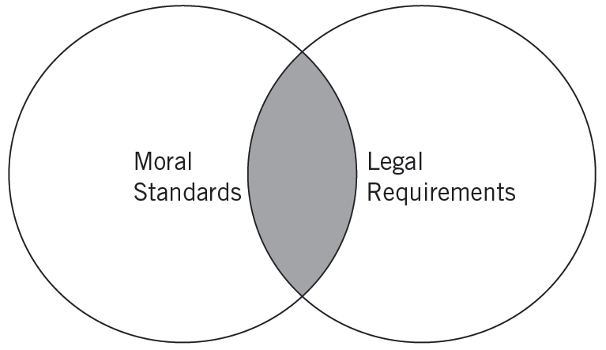
^{Figure} 4.2 Overlap between Moral Standards and Legal Requirements
© 2012 Cengage Learning. All rights reserved.

Slide 17
Economic Trade-Offs
Innovation, risk taking, and venture creation are the backbone of the free enterprise system which fosters individualism and competition.
  We cannot blame single individuals for the ethical problems of free enterprise.
  Rather, we must understand the total, systematic impact that free enterprise has on the common good.
© 2012 Cengage Learning. All rights reserved.

Slide 18
Reasons for Unethical Behavior
Greed
Distinctions between activities at work and activities at home
A lack of a foundation in ethics
Survival (bottom-line thinking)
Reliance on other social institutions to convey and reinforce ethics.
© 2012 Cengage Learning. All rights reserved.

Slide 19
Avoiding Another Enron Disaster
Bring hidden liabilities back onto the balance sheet.
Highlight the things that matter.
List the risks and assumptions built into the numbers.
Standardize operating income
Provide aid in figuring free-cash flow
© 2012 Cengage Learning. All rights reserved.

Slide 20
Establishing a Strategy for
Ethical Enterprise
Ethical Practices and Codes of Conduct
  A code of conduct is a statement of ethical practices or guidelines to which an enterprise adheres.
  Codes of conduct are becoming more prevalent in industry.
  Recent codes are proving to be:
    More meaningful in terms of external legal and social development
    More comprehensive in terms of their coverage, and easier to implement in terms of the administrative procedures used to enforce them.
© 2012 Cengage Learning. All rights reserved.

Slide 21
^{Table} 4.4 Approaches to Managerial Ethics
Organizational Characteristics | Immoral Management | Amoral Management | Moral Management
Ethical norms | Managerial decisions, actions, and behavior imply a positive and active opposition to what is moral (ethical). Decisions are discordant with accepted ethical principles. An active negation of what is moral is implied. | Management is neither moral nor immoral, but decisions lie outside the sphere to which moral judgments apply. Managerial activity is outside or beyond the moral order of a particular code. A lack of ethical perception and moral awareness may be implied. | Managerial activity conforms to a standard of ethical, or right, behavior. Managers conform to accepted professional standards of conduct. Ethical leadership is commonplace on the part of management.
Motives | Selfish: Management cares only about its or the company’s gains. | Well-intentioned but selfish: The impact on others is not considered. | Good: Management wants to succeed but only within the confines of sound ethical precepts (fairness, justice, due process).
Goals | Profitability and organizational success at any price. | Profitability; other goals not considered. | Profitability within the confines of legal obedience and ethical standards.
Orientation toward law | Legal standards are barriers management must overcome to accomplish what it wants. | Law is the ethical guide, preferably the letter of the law. The central question is what managers can do legally. | Obedience is toward the letter and spirit of the law. Law is a minimal ethical behavior. Managers prefer to operate well above what the law mandates.
Strategy | Exploit opportunities for corporate gain. Cut corners when it appears useful. | Give managers free rein. Personal ethics may apply but only if managers choose. Respond to legal mandates if caught and required to do so. | Live by sound ethical standards. Assume leadership position when ethical dilemmas arise. Enlightened self-interest prevails.
Source: Archie B. Carroll, “In Search of the Moral Manager,” Business Horizons (March/April 1987): 12. Copyright © 1987 by the Foundation for the School of Business at Indiana University. Reprinted by permission.
© 2012 Cengage Learning. All rights reserved.

Slide 22
A Holistic Approach
Principle 1: Hire the right people
Principle 2: Set standards more than rules
Principle 3: Don’t let yourself get isolated
Principle 4: The most important principle is
to let your ethical example at all times be absolutely impeccable
© 2012 Cengage Learning. All rights reserved.

Slide 23
Shaping an Ethical Strategy
The entrepreneur’s guiding values and commitments must make sense and be clearly communicated.
Entrepreneurs must be personally committed, credible, and willing to take action on the values they espouse.
The espoused values must be integrated into the normal channels of the organization’s critical activities.
The venture’s systems and structures must support and reinforce its values.
Employees throughout the company must have the decision-making skills, knowledge, and competencies needed to make ethically sound decisions every day.
Source: Adapted from Lynn Sharp Paine, “Managing for Organizational Integrity,” Harvard Business Review (March/April 1994): 106–117.
© 2012 Cengage Learning. All rights reserved.

Slide 24

Ethical Responsibility
Ethical Consciousness
Ethical Process
and Structure
Ethical Responsibility
Institutionalization
© 2012 Cengage Learning. All rights reserved.

Slide 25
Ethics and Business Decisions
Complexity of Ethical Decisions:
  Ethical decisions have extended consequences
  Business decisions involving ethical questions have multiple alternatives.
  Ethical business often have mixed outcomes.
  Most business decisions have uncertain ethical consequences.
  Most ethical business decisions have personal implications.
© 2012 Cengage Learning. All rights reserved.

Slide 26
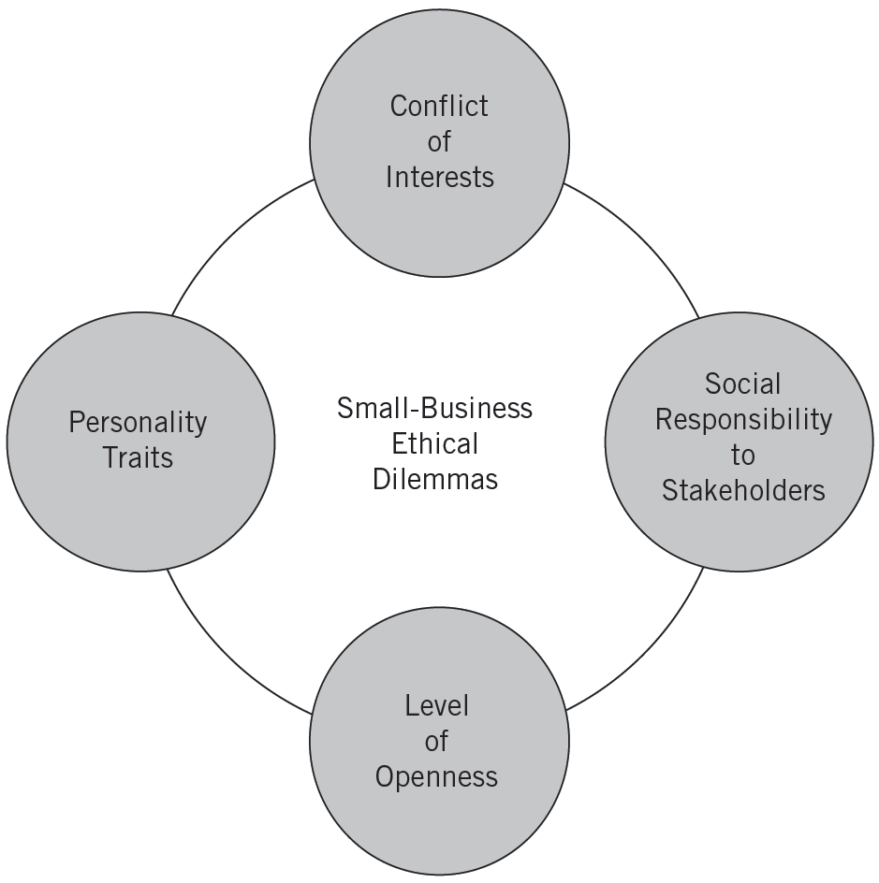
^{Figure} 4.3 Four Main Themes of Ethical Dilemmas for Entrepreneurs
Source: Shailendra Vyakarnam, Andy Bailey, Andrew Myers, and Donna Burnett, “Towards an Understanding of Ethical Behavior in Small Firms,” Journal of Business Ethics 16(15) (1997): 1625-1636.
© 2012 Cengage Learning. All rights reserved.

Slide 27
Questioning the Ethics of Business Decisions
Have you defined the problem accurately?
How would you define the problem if you stood on the other side of the fence?
How did this situation occur in the first place?
To whom and to what is your loyalty as a person and as a corporation member?
What is your intention in making this decision?
How does this intention compare with the probable results?
Whom could your decision or action injure?
Can you discuss the problem with the affected parties before making your decision?
Are you confident your position will be as valid over the long-term as it seems now?
Could you disclose without qualms your decision or action to your boss, your CEO, the board of directors, your family, and society as a whole?
What is the symbolic potential of your action if understood? If misunderstood?
Under what conditions would you allow exceptions to your stand?
© 2012 Cengage Learning. All rights reserved.

Slide 28
Ethical Considerations in Corporate Entrepreneurship
Corporate Entrepreneurs
  Are managers or employees who do not follow the status quo of their co-workers.
  Are depicted as visionaries who dream of taking the company in new directions.
  Often walk a fine line between clever resourcefulness and outright rule breaking.
© 2012 Cengage Learning. All rights reserved.

Slide 29
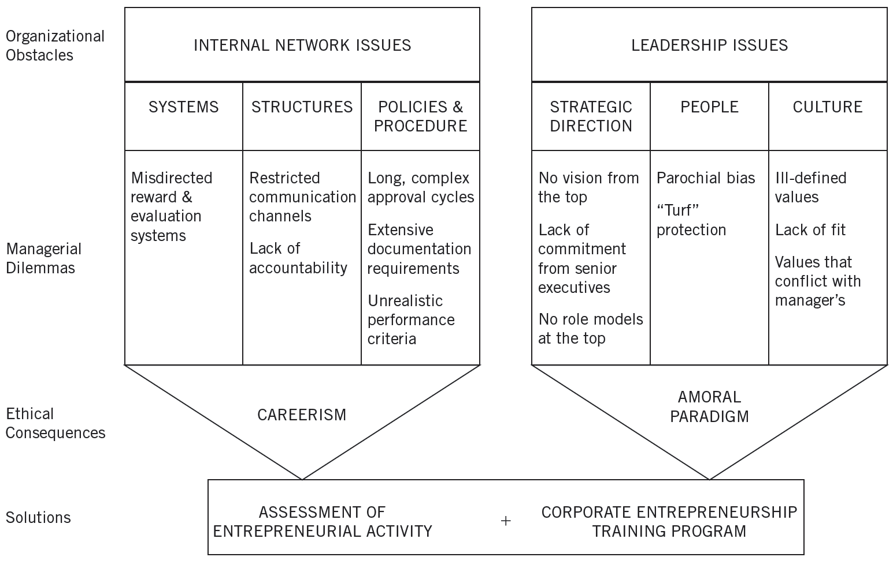
^{Figure} 4.4 Ethical Considerations in Corporate Entrepreneurship
Source: Donald F. Kuratko and Michael G. Goldsby, “Corporate Entrepreneurs or Rogue Middle Managers? A Framework for Ethical Corporate Entrepreneurship,” Journal of Business Ethics 55 (2004): 18
© 2012 Cengage Learning. All rights reserved.

Slide 30
Effective Corporate Entrepreneurship
Corporate Entrepreneurship requires:
  Establishing the needed flexibility, innovation, and support of employee initiative and risk taking.
  Removing the barriers that the entrepreneurial middle manager may face to more closely align personal and organizational initiatives and reduce the need to behave unethically.
  Including an ethical component to corporate training that will provide guidelines for instituting compliance and values components into state-of-the-art corporate entrepreneurship programs.
© 2012 Cengage Learning. All rights reserved.

Slide 31
Effective Corporate Entrepreneurship
Providing flexibility, innovation, and support
Removing organizational barriers
Effective Corporate Entrepreneurship
Including an ethical component to corporate training
© 2012 Cengage Learning. All rights reserved.

Slide 32
Ethical Leadership by Entrepreneurs
The Opportunity for Ethical Leadership by Entrepreneurs
  An owner has the unique opportunity to display honesty, integrity, and ethics in all key decisions.
  The owner’s actions serve as a model for other employees to follow.
  An owner’s value system is a critical component of the ethical considerations that surround a business decision
© 2012 Cengage Learning. All rights reserved.

Slide 33
^{Table} 4.5 Issues Viewed by Entrepreneur/Owners
Demands Strong Ethical Stance | Greater Tolerance Regarding Ethical Position
Faulty investment advice | Padded expense account
Favoritism in promotion | Tax evasion
Acquiescing in dangerous design flaw | Collusion in bidding
Misleading financial reporting | Insider trading
Misleading advertising | Discrimination against women
Defending healthfulness of cigarette smoking | Copying computer software
Source: Justin G. Longenecker, Joseph A. McKinney, and Carlos W. Moore,
“Ethics in Small Business,” Journal of Small Business Management (January 1989): 30.
© 2012 Cengage Learning. All rights reserved.

Slide 34
The Ethics of Caring
Caring
  A feminine alternative to the more traditional and masculine ethics that are based on rules and regulations.
Following laws may not lead to building as strong of relationships as one could.
Entrepreneurs must realize that their personal integrity and ethical example will be the key to their employees’ ethical performance.
© 2012 Cengage Learning. All rights reserved.

Slide 35
Key Terms and Concepts
amoral management
code of conduct
ecovision
environmental awareness
ethics
immoral management
moral management
nonrole
rationalizations
role assertion
role distortion
role failure
social entrepreneurship
social obligation
social responsibility
social responsiveness
© 2012 Cengage Learning. All rights reserved.

